Slide 1
Getting Started
Michael Yarichuk
Hibernating rhinos
michael.yarichuk@hibernatingrhinos.com

Slide 2
Design Guidelines of RavenDB
Eventual Consistency
Self optimizing
Zero admin
Simple and Intuitive API
Safe by default
Fast
It just works
Nothing is “never use in production”

Slide 3
Key concepts
Documents
Data
Metadata
Collections (of documents)
Indexes
Map
Map/Reduce
Attachments

Slide 4

RavenDB is ACID
Notes:
Available Consistent Isolated Durable (Data Store)

Slide 5
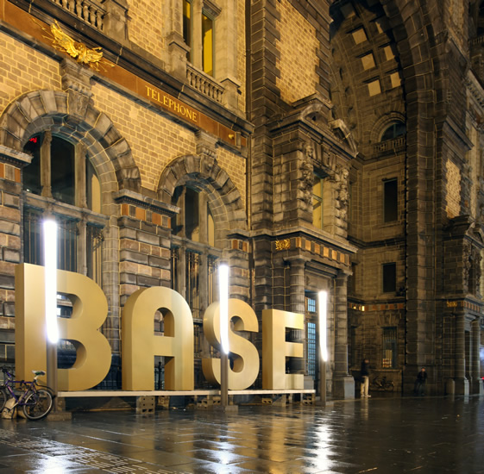
Aaand.. RavenDB is BASE
Notes:
Basically Available, Soft State, Eventually Consistent (Index Store)

Slide 6
What I mean is..
Document Store
Index Store
ACID
Documents (or attachments)
Limited queries (by key, key range, etag)
BASE
Map only or Map/Reduce
Complex queries
All the work done at indexing time
Queries on precomputed index

Slide 7
ETags
Sequential
Change on every PUT
Implications?
Notes:
Used for concurrency control

Slide 8
Safe by default
Page size
No computation during queries
Budgeted server calls
Automatic rebalancing of internal work
Notes:
Page Size → has BOTH client side and server side constraints.
Client side → if you do not specify Take() → Take(128) will be used
On server side → if page size is larger than 1024, → it will be capped to 1024
No computation during queries → indexes → precomputed data
What happens during first call? → talk about dynamic index creation
Budgeted server calls → Select N+1, default limit is 30
(per session set IDocumentSession.Advanced.MaxNumberOfRequestsPerSession)

Slide 9
RavenDB vs. RDBMS
RavenDB documents are ACID
Queries are BASE
Promise: The results of this query are current as of particular time.
No locks
Can wait, if desired. User get to chose.
Data & queries are ACID
Promise: The results are current as of right now*.
* Depending on isolation level.
Requires locks

Slide 10
Unique Identifiers
String
Unique across all docs
{collection}/{uid}
Guid
HiLo
Sequential
Any string
(Merely a convention)
Notes:
Do not forget to mention that GUID as ID of document is not always good → not human readable

Slide 11
Metadata
For data used to *describe* a document
Internal metadata:
@id
@etag
Last-Modified
Temp-Index-Score
Several ways to access and modify

Slide 12
Questions so far?

Slide 13
API – Basics
Document Store – different implementation for deployment scenarios.
Windows Service/Web Server hosted → DocumentStore
In-Process persistent/in memory → EmbeddableDocumentStore
For using under a sharding scenario → ShardedDocumentStore
Document Session
Unit-of-work implementation
Holds cache
Transactional
Notes:
Do not forget to add → DocumentStore thread safe, expensive to create, DocumentSession is NOT thread safe, cheap to create

Slide 14
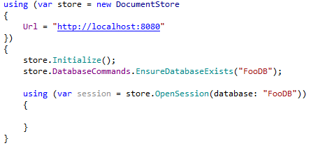
API - Basics

Slide 15
Practice – Basic CRUD

Slide 16
Queries
Linq - session.Query<User>();
Lucene Query – session.Advance.LuceneQuery<User>();

Slide 17
What is available?
Equality == and !=
Comparisons: >, <, >=, =<
Any()
In()
Search()
Intersect()
Ordering: OrderBy, OrderByDescending, OrderByScore
Projections: Select(), As(), OfType()
Paging: Skip, Take()

Slide 18
Querying Collections
Find a user by phone
Use Linq & Any()

Slide 19
Query Behavior
Paging (128 by default, max 1024)
Results are tracked if entities
Changes will be committed on SaveChanges()

Slide 20
What are we querying on?
We queried without creating an indexes.
What are the implications?
In RDBMS, Table Scans
In RavenDB… ?
Notes:
Do not forget to mention about Streaming API needing non-dynamic indexes!

Slide 21
Practice - Queries

